Slide 1
Digital portfolio employees
STUDENTS NAME:ASIN
REGISTER AND NMID:
24131132805222002/asanm11324131132805222002
DEPARTMENT:Bsc.DATA SCIENCE
COLLEGE: VALLALAR ARTS AND SCIENCE COLLEGE, ANNAMALAI UNIVERSITY

Slide 2
Project title
Digital portfolio employees

Slide 3
Agenda
Problem statement
Project overview
Objective
End user
Tools and technologies
Portfolio design and layout
Features and functionality
Benefits for employees
Conclusion

Slide 4
Problem statement
Traditional resumes are static and fail to represent complete employee skills, projects, and achievements. Employees often lack a professional platform to showcase their work in digital format. Employers face challenges in evaluating employee potential and verifying their real capabilities.

Slide 5
Project overview
This project aims to design a Digital Portfolio System for Employees. It allows employees to create, manage, and share their work, certifications, and achievements online. The portfolio will act as a dynamic resume that highlights both technical and soft skills.

Slide 6
Objective
To build a professional digital space for employees. To enhance employee visibility and career growth opportunities. To help employers assess employee skills effectively. To provide easy access to employee achievements for performance appraisal and promotions.

Slide 7
End user
Employees – to present skills, certifications, and projects. Employers/HR – to evaluate employees’ capabilities for hiring/promotion. Clients – to understand employee expertise before project collaboration.

Slide 8
Tools and technologies
Frontend: HTML, CSS, JavaScript Backend (optional): PHP / Python / Node.js Database: MySQL / MongoDB Platforms: LinkedIn, GitHub, Behance, Canva, Google Sites (for portfolio design)

Slide 9
Portfolio design and layout
Profile Section: Name, Role, Contact Resume & Bio – Short professional introduction Skills & Certifications – Technical + Soft skills Projects Showcase – Work samples, code, designs Achievements & Testimonials – Recognition and feedback Contact/Links – Email, LinkedIn, GitHub, Website

Slide 10
Features and functionality
User-friendly and responsive design Secure login for employees (if web app) Upload option for projects, certificates, documents Downloadable resume in PDF format Shareable portfolio link (online visibility) Search & filter (for employers to view skills)

Slide 11
Benefits for employees
Builds professional identity beyond a traditional resume Increases chances of promotions and career opportunities Improves online visibility and networking Easy way to share skills and achievements with employers/clients

Slide 12
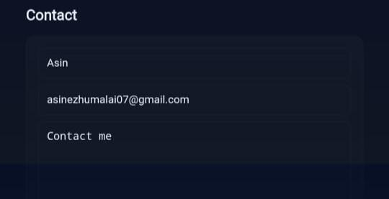

Slide 13
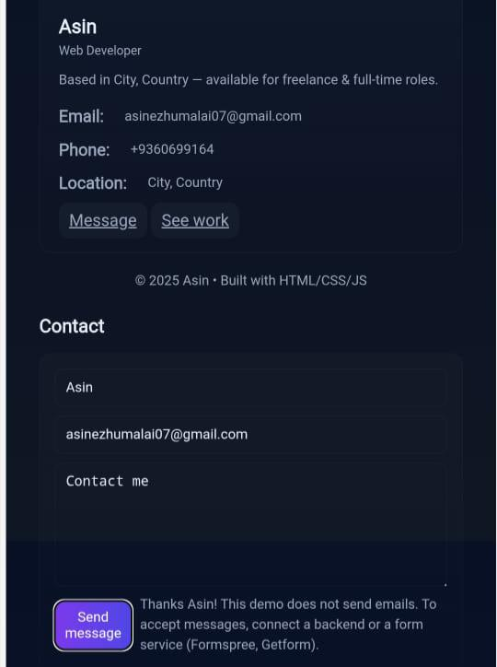

Slide 14
Conclusion
Digital Portfolios act as a modern replacement for resumes. They help employees showcase their work dynamically and effectively. Employers benefit from simplified evaluation and talent recognition. A Digital Portfolio is an essential tool for career growth in today’s competitive world.

